Slide 1
Criminal Justice Improvement Committee
GRANT WRITING WORKSHOP
Navin Puri, Lead Planner, Governor’s Crime Commission Navin.Puri1@ncdps.gov Keyon Ashe MBA, Criminal Justice Planner, Governor’s Crime Commission Keyon.Ashe1@ncdps.gov

Slide 2
Mission Statement
“The mission of the Criminal Justice Improvement Committee is to encourage proactive and innovative programming and methodologies that improve the criminal justice system. Desired improvements include reducing and discouraging violent crime and associated problems, enhancing all aspects of criminal justice processing to include the incarceration and treatment of offenders and advancing justice system operations”

Slide 3
2023 Funding Priorities
Local Law Enforcement Block Grants
Statewide/Regional Infrastructure
Statewide Accreditation
Crisis Intervention Training
Mental Health/Law Enforcement Project

Slide 4
Local Law Enforcement Block Grants
Federal Funding Maximum: $29,500/$10,000 Minimum (One Year Only)
Who May Apply?
Law enforcement agencies that do not qualify for Direct JAG Awards from the U.S. Department of Justice. First priority will be given to those that did not receive a block grant.
After much discussion among the CJI Committee, the Committee realized that in order to keep the Local Law Enforcement Block Grants priority a viable priority, it will need to limit what types of items are requested.
This year, the Committee has decided to focus on some of the more important and critical types of equipment that can be used to benefit law enforcement agencies and that is what they will be seeking solicitations for.

Slide 5
Local Law Enforcement Block Grants
ALLOWABLE EXPENSES
Allowable Requests this year will be
Radios (priority given to VIPER Radios)
Cameras (priority given to Body Cameras, but other like purpose devices can be requested, but will be given lower priority including In-Car Cameras and Street Cameras)
Body Armor (must be made in the United States of America)
Mobile Data Terminals
Non-Lethal Weapons
The Committee has determined that these five items are some of the most important tools in helping to ensure the public safety of both the officers and the citizens at large. These are what can be applied for under the Local Law Enforcement Block Grant Priority. Other requests can be submitted, but will be given a lower priority.

Slide 6
Local Law Enforcement Block Grants
(continued)
Points to Remember:
Items prohibited include air cards, phone lines, and any other long term contractual services…No vehicles or aircrafts may be purchased or leased. No unmanned aerial vehicles (Drones).
No vehicles that must be registered with the North Carolina Department of Motor Vehicles can be purchased.
Agencies that submit multiple applications will be automatically disqualified.
Agencies that are requesting body worn cameras must have a departmental policy on the use of body-worn cameras and a data storage solution plan which must be uploaded into the GEMS System and submitted by the application deadline.

Slide 7
Bulletproof Vest Purchases
Law enforcement agencies purchasing vests must certify that they have a written “mandatory wear" policy in effect for at least all uniformed officers while on duty. There are no requirements regarding the nature of the policy.
Certification of the policy must be received by GCC within 30 days of grant implementation & prior to their purchase.
Bulletproof Vests must be American made.
A Concept and Issues paper and a Model Policy can be obtained from the BVP Customer Support Center at vests@usdoj.gov or toll free at 1–877–758–3787.

Slide 8
Statewide/Regional Infrastructure
Federal Funding Maximum: $200,000 per year (up to 2 years)
State infrastructure initiative
This is for STATE AGENCIES ONLY and will include agencies housed under the North Carolina Department of Public Safety, the North Carolina Administrative Office of the Courts, the North Carolina Department of Justice, and individual Law Enforcement Agencies in the University of North Carolina System.
These applications will not be submitted for Committee review until communications have occurred between the lead CEO of the above mentioned agencies, GCC Staff and the Chair of the CJI Committee. This will help all parties in making the application process a more efficient and less labor-intensive process.
Regional infrastructure initiative
This is for local governmental agencies that are working to fund a regional project that service a minimum of 5 counties in North Carolina or a minimum combined population of 400,000 in the service region. These could include regional crime labs, regional joint infrastructure projects, or regional violence reduction initiatives.

Slide 9
Statewide Accreditation
The Criminal Justice Improvement Committee realizes the importance of both the National Commission on Law Enforcement Accreditation (CALEA) standards and the importance of the statewide North Carolina Law Enforcement Accreditation (NCLEA) standards for all law enforcement officials.
It is imperative that law enforcement officers, regardless of agency size and community wealth, be trained in sound criminal justice policies, procedures, and live training scenarios. National and Statewide accreditation standards are one practical way to help ensure that local law enforcement staff are trained to the highest standards.
Criminal Justice Improvement Committee is seeking applications for statewide training for law enforcement officials, as well as, applications for establishing accreditation standards and ensuring those standards are met by every law enforcement agency in our state.
State Agencies who are tasked with ensuring that these standards are met on a statewide basis may apply for up to $400,000.
Local Law Enforcement Agencies may apply for up to $ 50,000 (based on size of agency) to help support their agency achieve either or both the National and the State Standards.
Funds can be used to pay for the accreditation fees, support for officer overtime to allow release time - which must be documented by time and activity sheets, supplies needed to support the accreditation efforts for assistance in reviewing and improving agency policies and procedures

Slide 10
Crisis Intervention Training Up to 2 years Regional Application (Up to $ 200,0000 per year) Local Agency (Up to $ 75,000 per year)
The Criminal Justice Improvement Team is seeking applications from Law Enforcement Agencies that are seeking to utilize the Crisis Intervention Team Model in their law enforcement efforts.
Seeking to fund efforts by the North Carolina Justice Academy and/or other community partners to broaden and enhance the Crisis Intervention Model as implemented in North Carolina.
Seeking applications for law enforcement agencies who are seeking support to ensure that their officers complete CIT training.
The Criminal Justice Improvement Committee will also be considering applications for a regional team approach to CIT Training.
These applicants must demonstrate and ensure that their project will provide CIT training and implementation support in at least 3 counties or more for consideration as a regional project.
Applicants may apply for registration costs, supplies, and travel to ensure that officers and other staff (e.g., dispatchers, advocates or other staff interacting with the public) are able to partake in this training.

Slide 11
Mental Health/Law Enforcement Project Up to 2 Years
Projects will be categorized into three types:
Small Category (Population 50,000 or Less): Up to $ 75,000/year
Middle Category (Population 50,001 – 200,000): Up to $ 120,000/year
Large Category (Population 200,001 or higher): Up to $ 225,000/year

Slide 12
Mental Health/Law Enforcement Project (Continued)
Criminal Justice Improvement Committee is soliciting applications to fund a small number of projects in this priority.
Applicants can apply for up to two years of funding in accordance with the stated federal funding maximum for their jurisdiction.
The Committee is seeking to fund no more than one or two in each category for mental health diversion and co-responder projects.
Agencies are asked to demonstrate a collaborative and unified effort in their community approach to the growing problem of mental health.
Models that can be used include those that are promoted by the National Alliance on Mental Illness and these pilot projects must show an association between local law enforcement agencies, mental health service providers, and local government support.

Slide 13
Resource

Slide 14
General Information To be included in all Project Narratives:
Explanation of budget items should be provided in the Project Narrative.
Provide an estimation of the number of participants for the Training projects and the impact that it will have statewide.

Slide 15
General Information for Non-Profits
Must strictly follow the established reporting guidelines for all progress and implementation reports as outlined at:
http://www.ncgccd.org/planning/cji/nptreat.pdf
Must verify Non-Profit Status when submitting their application. (i.e. a current 501(C)(3) certification and have a valid federal tax identification number).
Required to provide a copy of the agency’s general accounting procedures, operating oversight structure and current financial statement with the application.

Slide 16
General Information for Non-Profits
(continued)
Should have a letter of commitment of collaboration for their proposal from a state or local partnering governmental agency.
A site visit by GCC staff will be required prior to the application being considered for funding for first time applicants.

Slide 17
Sustainability
The funds awarded by the Governor's Crime Commission are mostly intended for seed money.
All applicants must submit viable and detailed long-term sustainably plans.
They must clearly explain how and from whom they plan to secure funding - and program continuation - after the end of the project’s grant period.
And the answer is…

Slide 18
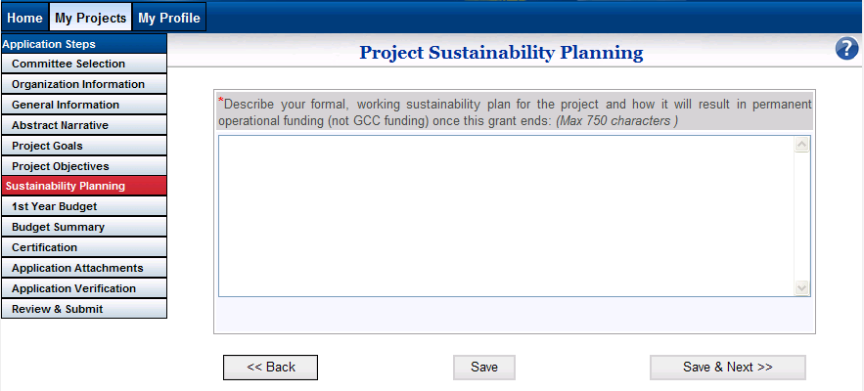
Sustainability
“…to seek additional funding through the NC Governor’s Crime Commission.”

Slide 19
Why Seek Alternative Funding?
NEXT YEAR IS NOT CLEAR BY A LONG SHOT.
JAG is shifting priorities and types of subgrant projects.
The decreasing number of Federal JAG dollars to NC each year.
CJI funding priorities change from year-to-year.
CJI funding is intended to seed new programs.
CJI funding may not be available to grantees after two or three grant cycles. Grantees are expected to have independent funding.
Funding is competitive, not all applications are funded.

Slide 20
Sustainability
Name three specific activities that will be accomplished during the first year of grant to financially sustain project once grant ends.
Name community resources that have the potential to partially sustain your project in the future.
Provide a brief description of your plan to financially sustain this project after the one year grant period.

Slide 21
Before You Begin >>>>
STOP
Every Applicant must have a DUNS Number and register with NCID at the time of application submittal.
(The Central Contractor Registration (CCR) has been moved into a new System for Award Management (SAM).
Every Applicant must have an active SAM Registration at the time of application and must renew it yearly.
Authorizing Officials, Financial Officers and Project Directors must each have individual NCID# associating them to the registered agency at the time of application submittal.

Slide 22
Choosing a Project Name
The project should be structured as follows:
Fiscal Year - Organization/Jurisdiction – Project Name
Examples:
2023 – Mayberry Police Department – Taser Project
-or-
2023 – Department of Justice – Training Project

Slide 23
Questions???

