Slide 1
Criminal Justice
Improvement Committee
Grant Award Workshop Breakout
September 2024 “You don’t know what you don’t know.” -- Anon

Slide 2
Grant Opening
The Notification Letter

Slide 3
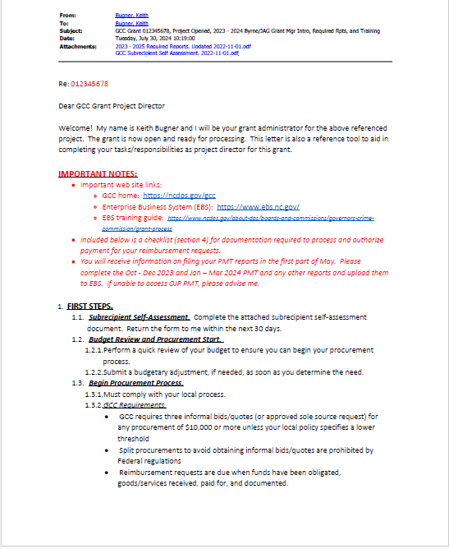
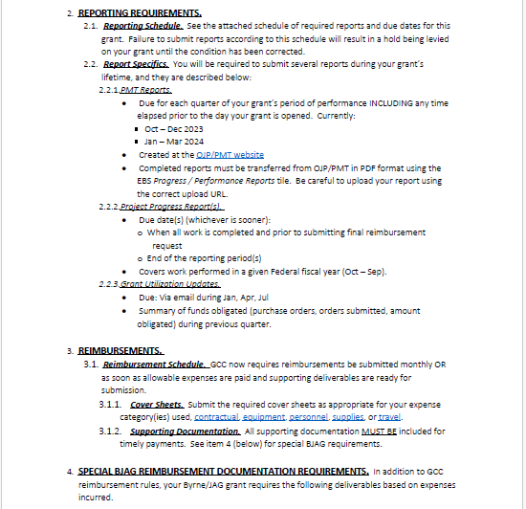

Slide 4
Important Notes
Web sites, reporting and other good stuff

Slide 5
Web sites:
GCC home page: https://ncdps.gov/gcc
Enterprise Business Systems (EBS): https://www.ebs.nc.gov
EBS User Add/Change: https://www.ebs.nc.gov/sap/crmaccess/
PMT Reporting: https://bjapmt.ojp.gov
Prior quarter PMT reports: You are responsible for submitting for any grant quarters prior to the date your grant opened. PMT instructions will be covered later.

Slide 6
First Steps
Self assessment, budget review/update, procurement

Slide 7
Self-assessment: Complete and return self-assessment form attached to introduction letter.
Budget Review and Procurement Start
Perform a quick review of your project budget, determine if anything needs updating from when grant was submitted.
If changes are needed, complete an EBS Change Request, budget section. Your GA can help with this. DO THIS AS SOON AS YOU SEE THE NEED.
Procurement Process Start.
Procurement MUST follow your agency’s procurement process.
GCC Requirements
Procurements >= $10,000 must have three informal bids/quotes OR approved sole source provider request. If your policy is stricter, follow it (See 3a, above).
Split procurements to avoid bids/quotes are prohibited by Federal regulations.
Reimbursement requests are due once funds have been obligated, items received, paid for, and documented.

Slide 8
Reports you Must Submit – see attachment to letter for details
Performance Management Tool (PMT)
Quarterly report required by US DOJ
Completed on DOJ website (more later)
Question and answer format
Copy of completed report to be upload to EBS as activity
Grant Utilization Update
A quarterly summary of funds obligated and progress notes. Look for an email from your GA for details.
Annual Progress Report(s)
An annual (per Federal fiscal year) report card on how well your project met your goals and objectives. Report template (Annual Progress Report) is found in the Grant Information > Grant Forms > Post Award section of the GCC website.

Slide 9
Reimbursements
Ins and Outs of Getting Paid

Slide 10
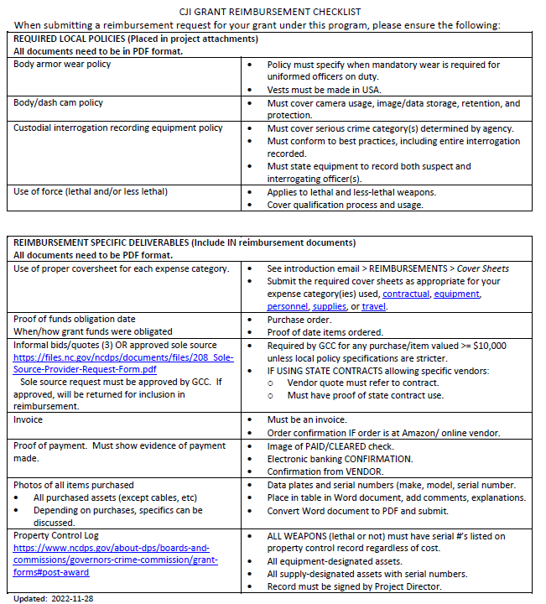
Reimbursement Checklist

Slide 11
So, You’re Going to Hire a Consultant
When a Contract Required and Pitfalls to Avoid
A consultant is someone working for you NOT ON YOUR STAFF
Contract salary limit is $81.25/hr AND $650.00/day (yes, we check that)
Duties/deliverables must be clearly stated
Pre-approval a Must
Pre-approval form available in Forms > Post-award section of GCC website
Must be approved prior contract execution.
This avoids non-allowance of pre-approval fees AND/OR a requirement to re-accomplish the document before any payment allowed.
NOTE: If you sign a contract that has not been approved that the consultant will not re-accomplish, you may be financially responsible for the entire contract!
Consultant must Prove Work Performed Consultant must fill out a time and activity form (available at Forms > Post-award section of GCC website)

Slide 12
Program Performance Measures for Justice Assistance Grant (JAG) Programs

Slide 13
Performance Measurement Tool (PMT)
Federal statutes REQUIRE PMT reports be submitted on-line directly to BJA, in a timely manner.
A PDF copy must be provided quarterly to GCC through EBS as an Activity with a title referring to the reporting period.
Your GCC grant administrator will review your report and either approve it or return it for further action.
GCC Planning Staff must then compile & enter its own compilation report to BJA.
Failure to observe these conditions and deadlines may result in an immediate hold of grant funds and may endanger the State’s entire allocation. If the state report is not submitted in time, OJP can put a hold on the state allocation.

Slide 14
Website
FY 2024 JAG PMT Measures Web site:
https://bjapmt.ojp.gov/

Slide 15
Terms Used
GRANTEE | The primary recipient of a Federal award from BJA. This organization submits an application to BJA for the Federal award—for example, the state, local recipient, or fiscal agent.
GRANTOR | The organization that makes secondary awards to other entities from the BJA award. Usually the same as the grantee—for example, the state, local recipient, or fiscal agent.
GRANT | The funding or award received from BJA.
SUBRECIPIENT | An organization or agency that does not receive funds directly from the Federal government but from the state or another agency.
SUBAWARD | The secondary award made from the grantee’s Federal award.
PROJECT DESCRIPTION | A short description of the project that the application represents, and the purpose of the requested funds.
REPORTING PERIOD | A time period in which activities were conducted and funds expended and obligated. This period falls within the grant’s project period. Example: January to March and April to June, for quarterly reporting.

Slide 16
Step 1: Log In

Slide 17
Step 1: Log In
Users added to the subrecipient account by the grantee will receive an e-mail from BJA PMT with instructions on how to create a new user account.
Enter information in all required fields, and click Update to continue.

Slide 18
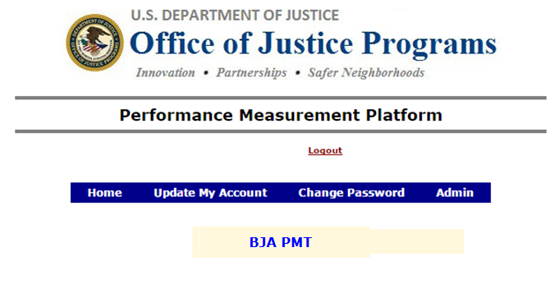
Step 1: Log In
Here you can update or change your account and password information.
Click BJA PMT to continue.
Notes:
[READ SLIDE]

Slide 19
Step 2: Profile
Select the Grantee Organization or Subgrantee Organization profile, depending on your role, to enter/edit data.

Slide 20
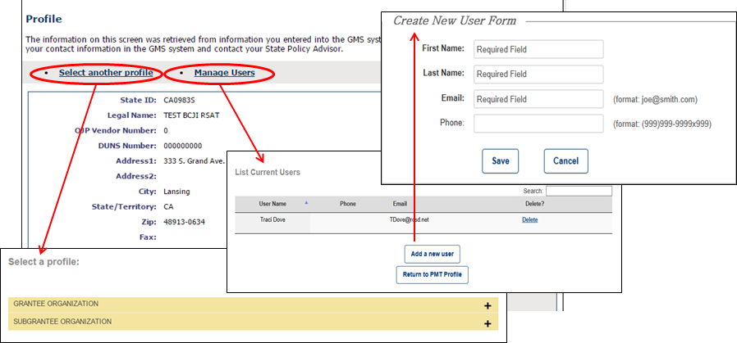
Step 2: Profile
Check your profile for accuracy.
If any changes are needed, contact your grantor.
Click Select another profile to go back to the list of your assigned profiles (if applicable).
Click Manage Users and Add a new user or Delete to update the list of users.
NOTE: Only add users who need access to the BJA PMT to complete data entry and reporting. Adding a user automatically sends that person an e-mail with a link to create and complete a user account.

Slide 21
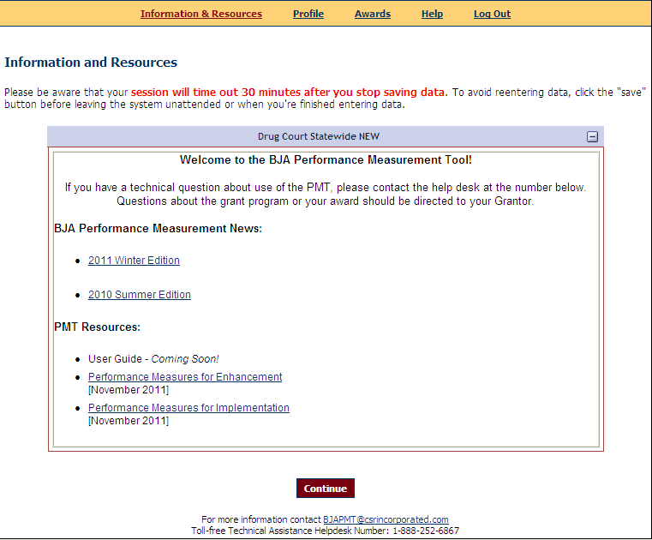
Step 3: Information and Resources
Use the navigation bar at the top to access different pages in the system.
Do not use the back arrow on your browser.
The system will time out after 30 minutes of inactivity.
You can find the following on the Information & Resources page:
PMT user guide
Performance measures
Other resources

Slide 22
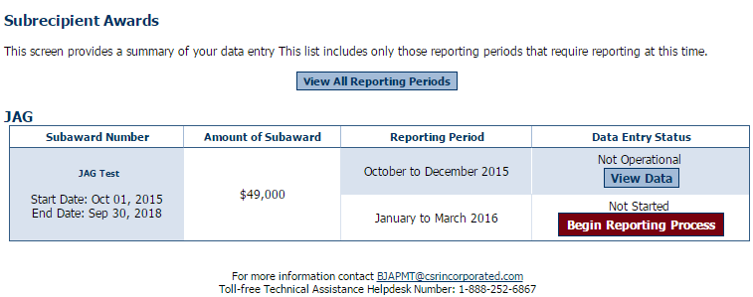
Step 4: Subrecipient Awards
The purpose of the Subrecipient Awards page is to give an overview of data entry for all awards.
Select the reporting period, and click Begin Reporting Process.
Each page has the contact information for the PMT Help Desk.

Slide 23
Step 4: Subrecipient Awards
Status on the Subrecipient Awards page:
Not Started: Subrecipient has NOT saved any data.
In Progress: Subrecipient has begun entering data but has not completed the data entry process.
Complete: Subrecipient has entered and saved data; the record is marked as complete.

Slide 24
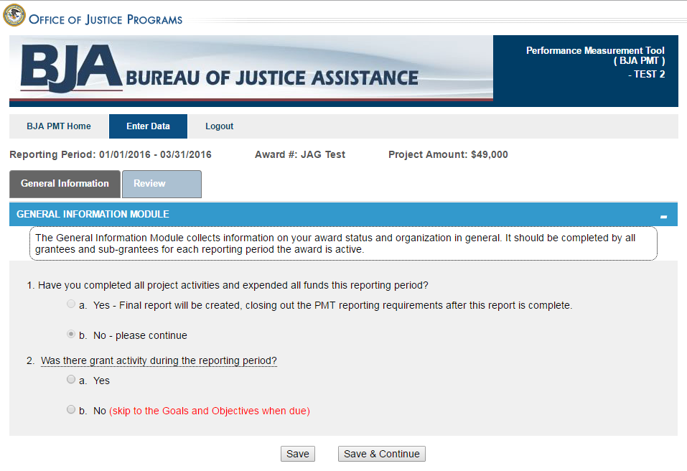
Step 5: General Award Information
The General Information page is intended to determine whether or not there was any grant activity during the reporting period.
Check Yes if there was grant activity.
Check No if no activity occurred and no funds were expended, and explain.
Click Save & Continue to continue reporting.

Slide 25
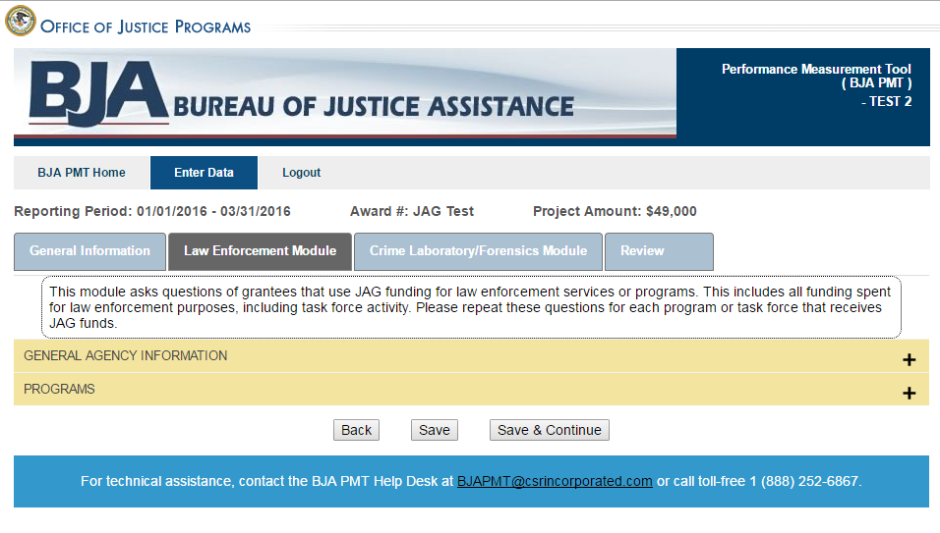
Step 6: Data Entry
Tabs allow you to move between different activity/program modules.
More tabs will appear based on your funding allocations.
Accordions expand to show the questions within the different sections in each module.
Enter data for all fields. When you are finished, click Save & Continue to move on to the next tab. Click Save if you need to save your data and continue working on the rest of the questions later.

Slide 26
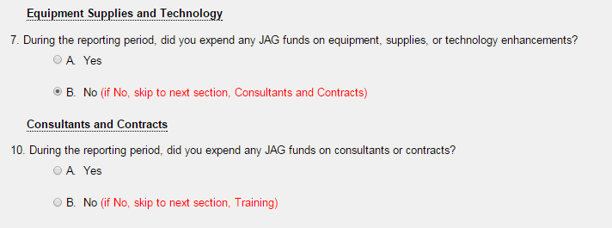
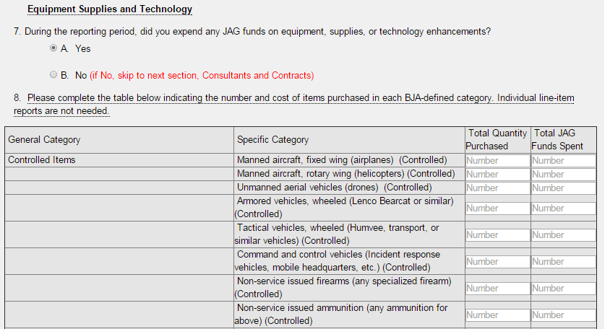
Step 6: Data Entry
Skip questions determine whether or not you need to answer additional questions related to a specific service or activity.
If you need to answer additional questions, the skip question will expand. If not, no questions appear.

Slide 27
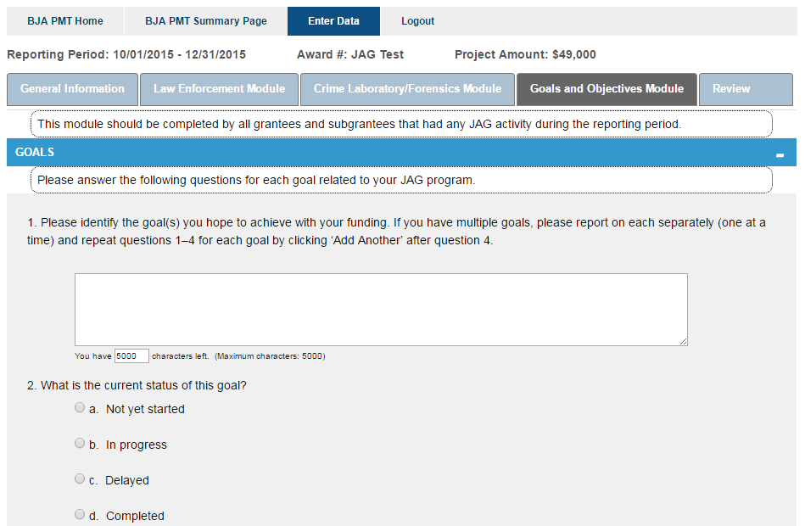
Step 6: Data Entry (Goals and Objectives)
During the April–June and October–December reporting periods, you will see the Goals and Objectives questions. Your response to these questions should reflect activity during the previous 6-month period (January–June or July–December), regardless of whether or not your award was “operational.”
If you’re closing out the award and this is the last reporting period of data submitted in the PMT, your response should reflect activity since your last submission of goals and objectives data in the PMT.

Slide 28
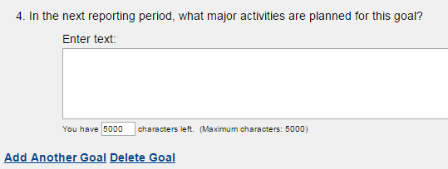
Step 6: Data Entry (Goals and Objectives)
On the Goals and Objectives tab, answer questions regarding each of your program’s goals. Click Add Another Goal or Delete Goal to add or delete a goal entry. Once you have answered all questions, click the Activity tab to finish answering questions for the section.

Slide 29
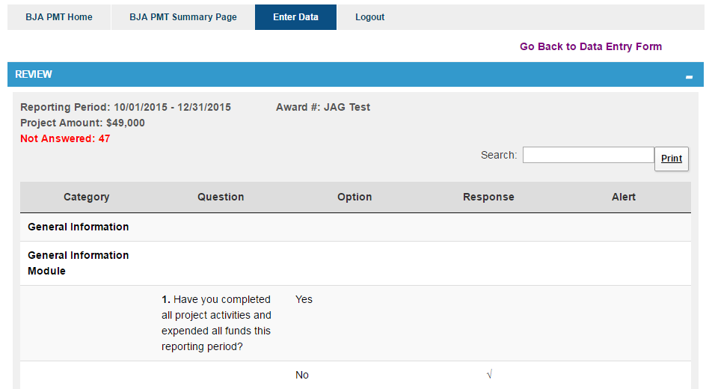
Step 6: Data Entry (Review)
This link allows you to return to previous pages to view and/or edit data.
The total number of alerts is listed here.
You can search and print from here.
The Review page allows you to view any required questions you need to answer. This page breaks down the measures by Category, Question, Option, Response, and Alert. If you have not answered a required response, this will appear in the Alert column.

Slide 30
Step 6: Data Entry (Complete)
Once you have completed and reviewed all data entry, check the Mark Data as Complete box and click Save. The saved data will then be submitted to your grantor.
This action will PREVENT you from further entering or editing data or information. Please be sure your data entry is final before checking the Mark Data as Complete box.
If you need to make changes to your data after you have submitted it, contact your grantor and request that your data be unlocked.
If you want to explain the data you reported, enter text in the Additional Comments box.

Slide 31
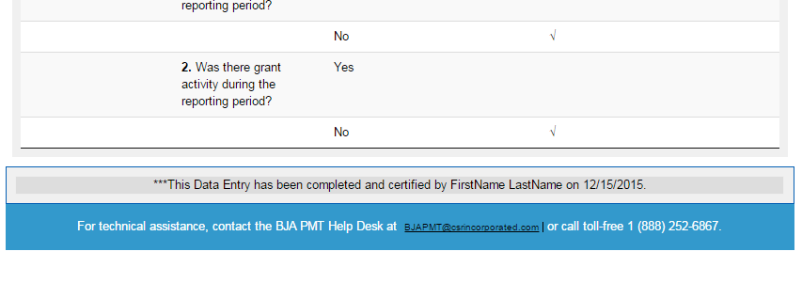
Step 6: Data Entry (Complete)
The system will now show data entry as complete and certified at the bottom of the Review tab.

Slide 32
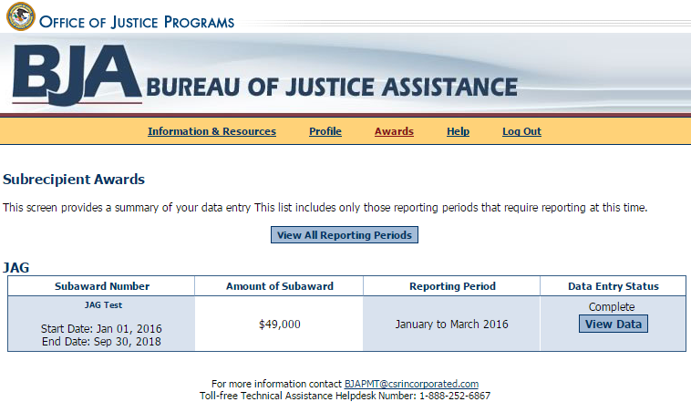
Step 6: Data Entry (Complete)
View of Data Entry Status and Report Status
You can confirm data entry has been successfully completed and created by the Data Entry Status (Complete) column.

Slide 33
Helpful Hints
What If . . .
My award is not operational?
An award is ‟not operationalˮ when activities proposed in the BJA-accepted grant application have not been implemented or executed with the BJA grant.
I get an error message?
Follow the instructions to correct any errors or discrepancies.
If you have questions, contact the PMT Help Desk.
I need to edit data that I submitted, and I already created a report?
Contact your grantor and request that the report be unlocked or returned to you for revisions.
The award point of contact information on the profile page in the PMT is not correct?
Contact your grantor to ensure it is aware of any changes.
I lost my data!
Please be aware that your session in the PMT will time out 30 minutes after you stop saving data. To avoid losing and having to reenter data, click Save periodically, before leaving the system unattended, or when you have finished entering data.

Slide 34
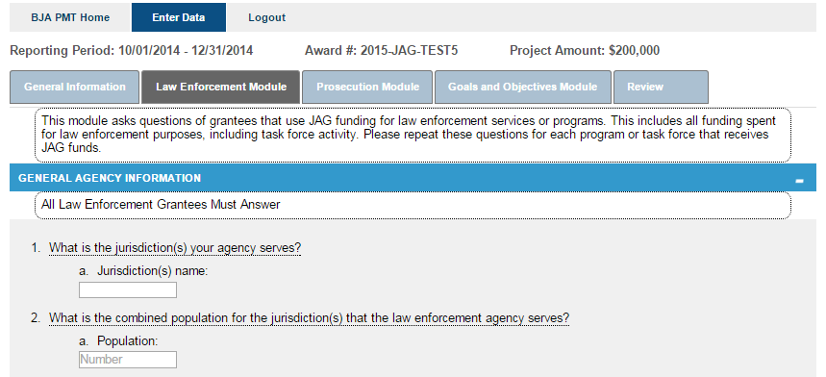
Helpful Hints
If you have a question about what a question means . . . Hover the mouse over the underlined question to see the instructions.

Slide 35
Resources
BJA PMT Web Site: https://bjapmt.ojp.gov/
For questions about your program performance measures data reporting requirements and deadlines, contact your grantee.
For questions about the PMT, contact the BJA PMT Help Desk:
Monday–Friday 8:30 a.m.–5:30 p.m. ET
Toll-free number: 1-888-252-6867
E-mail: bjapmt@usdoj.gov

Slide 36
Reporting Status
Not Started – No data has gone into the PMT system for this reporting period.
In Progress – Data has been entered, but not completed and submitted. Please note that you there may be several pages of data to enter before the process is complete.
Complete – All questions have been answered error free and submitted to grantor.
Notes:
The only time your grant should appear NOT STARTED should be when you first begin each quarter’s report.
NOT OPERATIONAL - means no funds were expended and no activities occurred during the reporting period. If you had activities, but expended no money, your grant was operational ..
IN PROGRESS – means that information has been entered but not completed – AND Submitted. PLEASE REMEMBER TO SUBMIT the Report.
COMPLETE --- Means you have answered everything and submitted your PMT Report.

Slide 37
PMT Reporting Periods
PMT Reports are REQUIRED Quarterly!
…and are due the 10th of the month following the close of a quarter.
October 1 – December 31 (due January 10)
January 1 – March 31 (due April 10)
April 1 - June 30 (due July 10)
July 1 – September 31 (due October 10)
By the 10th of the month that these reports are due, the BJA PMT Report must be completed in the PMT Website and that report must be uploaded to the corresponding PMT Quarter tab in the GEMS system.
Notes:
With a start date of July 1, your first report will be due by October 10th.
They are REQUIRED Quarterly on the 10 day of the month following the close of the quarter.
We make every effort to notify all JAG grantees by the end of each quarter by email about the upcoming PMT due dates…
We expect the same from our grantees in responding by the due dates of the PMT Report.

Slide 38
Criminal Justice Planning Team
Navin K. Puri, Navin.Puri1@ncdps.gov
Keyon Ashe, Keyon.Ashe1@ncdps.gov
Matthew Stuart, Matthew.A.Stuart@ncdps.gov
Keith Bugner, keith.bugner@ncdps.gov
…Please contact the Criminal Justice Planning Team
for PMT reporting assistance.
If no one is available, please contact
The BJA PMT Help Desk at 1-888-252-6867

