Slide 1
US Department of Justice Pre-award Requirements October 30, 2024
Governor’s Crime Commission - Grant Writing Workshop
Notes:
NAVIN
Good Morning Everyone:
Today we will be reviewing some pre-award requirements. These will be things that you will need to be aware of while you are completing your grant application for your project. Sandy Dixon, our Lead Victim’s Service Planner and myself, Navin Puri, Lead Criminal Justice Improvement Planner will be conducting this presentation.
Let us begin.

Slide 2
Outline
Overview Planning Sections
Pre-Award Requirements
Project Budgets and Allowable Costs
Match
Indirect Costs
Notes:
NAVIN
This morning, we are going to give you a brief overview of the Planning Section at GCC, talk about some Pre-Award Requirements for the application, show some points regarding the Project Budget and Allowable Costs, then devote a few minutes to matching funds, and review changes to Indirect Costs.

Slide 3
GCC Planning Teams
Criminal Justice Improvement (CJI) | Juvenile Justice (JJ) | Crime Victim Services (CVS)
Byrne JAG, JAG PREA, RSAT, CSEF, JRJ, Coverdell, SORNA, NCHIP, SCIP, CVI | Juvenile Justice (JJ), JJ PREA, and CJA | Violence Against Women Act (VAWA) STOP and SASP | Victims of Crime Act (VOCA) Victim Assistance
Lead CJI Planner Navin Puri | Lead JJ Planner Adonicca McAllister | Lead CVS Planner Sandy Dixon
Keyon Ashe – Planner Matt Stuart – Planner/Grant Administrator Keith Bugner – Grant Administrator | Toni Lockley - Planner | Daun Brown-Hairston – Lead VAWA Planner Amanda Endicott – VAWA Planner | Lindsay Bohan – Lead VOCA Planner Jordan Mayer– VOCA Planner VACANT– VOCA Planner
MK Smith Administrative assistance |  | Grace Clougherty Program Assistant
Notes:
NAVIN
As you can see here by this slide, the Planning section is divided into three groups of staff. This staff works with procuring these funds listed into the State of North Carolina. This staff also works with the three standing committees by the same name that are derived from members of the Crime Commission.

Slide 4
Federal Requirements
Obtain UEI number
former DUNS number is no longer used
Log into SAM.GOV
NEW USERS
New entities can get their UEI at SAM.gov and, if required, complete an entity registration. https://sam.gov/content/duns-uei
Notes:
NAVIN
On April 4, 2022, the Unique Entity Identifier (UEI) used across the Federal Government changed from the DUNS Number to the Unique Entity ID (generated by SAM.gov). The Unique Entity ID is a 12-character alphanumeric ID assigned to an entity by SAM.gov. As part of this transition, the DUNS Number has been removed from SAM.gov. Entity registration, searching, and data entry in SAM.gov now require use of the new Unique Entity ID. Existing registered entities can find their Unique Entity ID by logging in to SAM.gov. In your Workspace, select the entity title of the "Entities" widget. The UEI is shown beside the entities. New entities can get their UEI at SAM.gov and, if required, complete an entity registration. https://sam.gov/content/duns-uei Please note that the GCC staff cannot assist you with UEI issues as this system is federally managed.

Slide 5
Request Access to EBS – GCC’s new grant management system – www.ebs.nc.gov
All applications MUST be submitted in EBS
Users MUST obtain an NCID
MYNCID.GOV (individuals)
NCID.GOV (state government employees)
Once you obtain an NCID, complete the EBS Access form https://www.ebs.nc.gov/sap/crmaccess/
This will be explained in more detail in the EBS presentation later today.
Notes:
SANDY
Here will give you an overview of the steps you need to take prior to starting your application. However, Kevin Farrell, will go into more detail and demonstrate this information later today.
First, you will need an NCID. Go to either myncid or ncid.gov depending on whether you are an individual outside of state government or an existing employee state government.
Then, you will need access to the GCC grants management platform EBS in order to create or review an application, or to manage or view an existing awarded grant,
Use Google Chrome to access the online EBS External Access Request Form.
Provide the details required by the form and submit it.
Your authorization for access will be processed over the next 48 business hours.
If approved, you will receive a “WELCOME TO THE GCC ENTERPRISE BUSINESS SYTEM” email. This email will come from the email address: sapacct@ncdot.gov. Please check to ensure that it has not gone to your spam folder.

Slide 6
GCC Project Budget Budget Categories & Allowable Expenses
Governor’s Crime Commission - Grant Writing Workshop
Notes:
NAVIN
This next section will give you some basic instructions and helpful tips as you are completing the budget section of your application.

Slide 7
All Budget Lines:
All budget lines must be described in the narrative, including
1. name of the item or position
2. a general description about how the item or position will support the project
3. and the percent of time or value that is charged to the project.
Ex. “Victim advocate #1 will dedicate 50% of their FTE hours to serving this project by…..”
Notes:
SANDY
Read slide

Slide 8
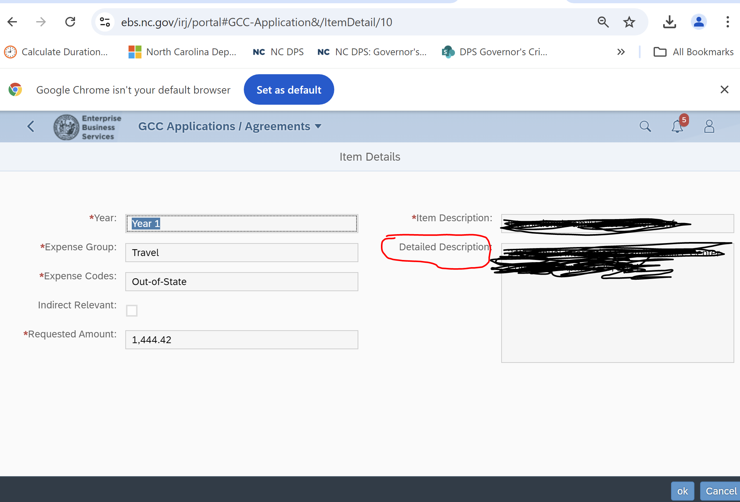
Show calculations in the Detailed Description: # of travelers, # of nights, location, rates
Notes:
SANDY
Note that EBS now contains a field inside of each budget line called “Detailed Description” as shown in the red circle here.
Here, in the Detailed Description field, show calculations such as the number of travelers times the number of nights times the cost per night for lodging. Another example would be to provide the employee’s full salary times the percentage of time spent on the project showing how you got the the salary amount for a position.
Also, here enter any additional details to describe the item that may have not fit in the narrative sections of the application.
This is important.
What we often see is that subrecipients enter a budget line name and that is all, such as a “magnatometer”.
Staff may need additional details about what a magnatometer is, why it’s necessary to the project and what portion or percentage of this item is being paid for by the grant. Please put this detailed information here. This will save you a lot of work later if your project is funded. If you don’t put this information here, staff will be required to get these details later and that require more work for you later and will slow down the award process.

Slide 9
Deeper dive into Budget Categories
Notes:
SANDY
Now we will take a deeper dive into budget categories.

Slide 10
Personnel:
Personnel costs must be “supported by a system of internal controls which provide reasonable assurance that the charges are accurate, allowable and properly allocated” and “based on records that accurately reflect the work performed.” See 2 C.F.R. 200.430.
Clear and consistent documentation is necessary per position
Pre-Award:
Job Description attachments are no longer required at application
100% of an executive director’s time cannot be charged to GCC
Post-Award:
Activity Reports
Timesheets
30%
20%
10%
25%
15%
Notes:
SANDY
One budget category is Personnel
There must be a reasonable and documented methodology for allocating the work performed through an internal system of controls and time keeping.
For instance, where employees work on multiple activities, cost objectives or projects or programs, a distribution of their salaries or wages must be supported by Time and Activity reports which meets GCC standards documenting their hours worked on the project by funding source.
Please note that an Executive Director’s time cannot be 100% charged to a single GCC project, nor in total to multiple GCC projects.

Slide 11
Budget Category: Personnel
Includes salaries or wages, fringe benefits, allowances, and other services provided by the agency to employees as part of the compensation package
Costs of fringe benefits are allowable as long as they are reasonable or required by law and paid to other non-grant funded positions
Examples: FICA, paid leave, health/dental/vision or other insurance, retirement benefits and mandatory costs including workers compensation and unemployment insurance
Notes:
NAVIN
Some items that will go into your Personnel Section will include salary and wages and fringe benefits. Keep in mind that fringe benefits are allowable as long as they are reasonable and the fringe benefits listed in your proposal should apply to personnel listed on the application that will be involved in this project.

Slide 12
Travel:
Program costs generally include which involves mileage, food, hotels, registration fees, and other expenses associated with staff attendance at technical assistance meetings, conferences, project staff volunteer training and relevant to the program. See eCFR :: 2 CFR Part 200 Subpart E -- Cost Principles; 2 CFR 475(d)
Must be directly related to the funded project
Costs must be in accordance with the agency’s written travel reimbursement policy, which cannot exceed the GSA rates (federal General Services Administration)
If agency does not have a written travel policy, North Carolina State Travel Policy must be followed, which now includes the GSA rates (section 5.2.1 found here: Budget Manual | NC OSBM).
Pre-Award:
Provide the agency Travel Reimbursement Policy
Post-Award:
Travel Logs
Documentation of registrations, receipts for reimbursements
Notes:
SANDY
Here we have provided you the definition of allowable travel costs
Be sure to describe how the travel benefits the project
Use your travel policy for reimbursement rates and show these calculations in the budget line Detailed description field.
The travel policy must be provided in the Organization Profile in EBS.
If you do not have a travel policy, you may use the state’s travel policy which can be found at the link included here for the Office of State Budget and Management’s Budget Manual.
Maintain documentation for all of the project funded travel, to include mileage logs, hotel, airfare and registration receipts that are reimbursed to employees.

Slide 13
Budget Category: Travel
Always include and show the number of travelers as the unit and the cost per person as the cost per unit
Examples of Travel Expenses: Lodging, per diem (meals), mileage, airfare, ground transportation, baggage, and other allowable expenses
Each type of expense should be listed on separate budget lines (tips are not an allowable expense)
Mileage should be your agency’s rate per your policy or the state policy if your agency does not have a policy.
Notes:
NAVIN
If you are requesting travel expenses, and I emphasize the Word IF on this category, please keep some of these items in mind. Please note that the purpose of these grant applications is to help implement a project or a program and not to be used as a travel fund. Travel for relevant and necessary aspects of the program are allowed, but please make sure that you do calculate the items carefully. You must be able to show the number of persons travelling, where they are travelling to, the purpose of that travel, a clear and itemized budget on the lodging costs, the per diem costs, mileage, airfare, and any baggage and ground expenses. This is a category that will be scrutinized heavily and in many cases, if there is a need to reduce the amount of a grant in order to be able to fund it, this is one of the first areas that may be asked to be reduced.

Slide 14
Equipment:
Any durable item with a useful life of more than one year and costing more than $10,000 per unit. See 2 C.F.R. § 200.1 2 C.F.R. § 200.465(c),2 C.F.R. §200.452,2 C.F.R. §200.436 ,2 C.F.R. §200.447, 28 C.F.R. 94.121(e)
Pre-Award:
Equipment over $10,000 that is PURCHASED, not leased
Provide Procurement or Purchasing Policies
If your policy capitalizes equipment at a lower threshold, your policy applies.
Post-Award:
Bids, if applicable
Receipts
Equipment tracking forms, logs, inventories with date of purchase and funding source
Notes:
SANDY
There is a change from prior years to the category of equipment.
Equipment is categorized now as items costing 10 thousand dollars or more per item or unit.
Have and use a Purchasing/Procurement policy for your agency.
This policy also must be provided in the Organization Profile in EBS.
Maintain all documentation for all purchases from the bidding process on through to invoicing and payment.
Additionally, GCC requires equipment be tracked and documented on an Equipment Inventory worksheet.

Slide 15
Budget Category: Equipment
Per the federal government: Equipment is defined as any durable item with a useful life of more than one year and costing more than $10,000 per unit
Nevertheless, agencies have to follow their written procurement or purchasing policies. If your policy has a lower equipment threshold, you must use that
Below is a sample table listing equipment to be purchased
Equipment | Unit Cost | Number of Units | Estimated Cost
Copier/Scanner/Fax Machine | $10,500.00 | 2 | $21,000.00
Total Estimated Cost |  |  | $21,000.00
Notes:
NAVIN
Here is an example of equipment. Note that the cost per unit is greater than 10K. Therefore these items qualifies for this budget category. Do not put these types of items in the Supply Budget category.

Slide 16
Supplies:
Supplies are property considered expendable, costing less than $10K (or per your agency’s policy for other supply purchases), and usually consumed in the course of the project. Costs incurred must be necessary and reasonable to the provision of services. See 2 C.F.R. § 94.4120
Pre-Award:
Attach a detailed list for General Office Supplies
Attach a detailed list for Program Supplies
Equipment Lease Agreements (not maintenance agreements if you have purchased the equipment)
Post-Award:
Receipts
Equipment Lease agreements
Notes:
SANDY
Supplies are any items under 10k per unit and include things such as general office supplies as well as program supplies.
General Office supplies can be listed as one line item and be sure to attach a detailed office supply list to your project.
Program supplies should be listed separately from General Office Supplies and a detailed program supply list should be attached to your project as well.
Equipment Lease agreement, where you have not purchased the item but instead you are leasing the piece of equipment, should also be listed here. Let’s review that again. Purchased equipment 10 thousand dollars or more goes in the Equipment budget category, but if you are leasing it, the equipment lease agreement item should be listed here.

Slide 17
Budget Category: Supplies
Below is an example of a budget for supplies to be purchased:
Supply Item | Quantity | Unit Cost | Total Cost
Office Supplies | 4 | $750 | $3,000.00
Cell Phones | 2 | 350.00 | $700.00
Laptop Computers | 2 | $900.00 | $1,800.00
Victim Personal Products (shampoo, soap, toothbrushes, toothpaste, etc.) | 50 | $10.00 | $500.00
Agency Brochures | 1,000 | $0.10 | $100.00
Total Estimated Cost |  |  | $6,100.00
NC Governor's Crime Commission
Notes:
NAVIN
This is an example of how the supplies items should be placed in the “Detailed Description” field for the line item in EBS. It should show the quantity and the Unit Costs for each item that is being requested in the budget.

Slide 18
Operating *NEW*:
Rent and utilities
Pre-Award:
Attach Rent Agreements
Post-Award:
Upload renewal Rent Agreements
Notes:
SANDY
New for this cycle you will see in EBS a budget category called “operating” expenses.
Please place your rent and utilities budget lines here.
Also be sure to upload your rent agreements to the project.

Slide 19
Conference Planning:
In general, conference hosts/sponsors must exercise discretion and judgment in ensuring that conference costs are appropriate, necessary and managed in a manner that minimizes costs to the Federal Award. See 28 C.F.R. 94.109. All conferences supported with GCC funding must receive prior approval in writing.
Pre-Award:
Narrative describes why the conference is necessary
Travel Reimbursement Policy
Post-Award:
Travel Logs
Documentation of travel, attendee lists, conference locations costs, etc.
Notes:
SANDY
For conferences which your agency will hold and are supported by the GCC grant project, please be aware that conference food and beverages are generally not allowable.
Maintain similar documentation for conferences as you would for other travel costs. Lists of attendees are also required to be maintained by your organization.
All conference costs must be approved by your GCC grant administrator prior to incurring the actual costs.

Slide 20
Conference Planning
Cost thresholds and limitations are in place for the following items:
Item | Cost *UPDATED*
Meeting room/audio-visual services | Lesser of $31.25 per day per attendee or $25,000
Logistical planners | Lesser of $62.50 per attendee or $11,000
Programmatic Planners | Lesser of $250 per attendee or $43,750
Food and Beverages | NOT ALLOWED
Refreshments | NOT ALLOWED
Notes:
NAVIN
If you are budgeting for a conference, keep in mind that these are the federal limits that are set for these items. The federal government set these limits are based on how much could be allocated per attendee. Food and Beverages are Not Allowed.

Slide 21
Governor’s Crime Commission’s Match Funding Requirement
Governor’s Crime Commission - Grant Writing Workshop
Notes:
SANDY
Now we will move on to discussing match.

Slide 22
Match Funding
How to calculate Match Funds
Acceptable forms of Match Funds
How to request a Match Waiver if you are not able to meet the funding requirements.
Notes:
SANDY
This section will explain GCC’s Match Funding requirements, how to calculate the required amount of Match Funds and how to request a Match Waiver if you are not able to meet the match requirements.

Slide 23
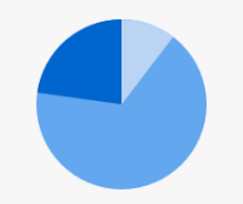
Match Funding
Portion not supported by Federal Funds.
Demonstrates strong base of financial and partner support for a project
Subject to the same regulations and restrictions as federal funding.
Match Share + Federal Share
=
Total Project Budget
Match Share
20%-25%
Federal Share
75%-80%
Notes:
SANDY
Match funding is the portion of a project’s costs not supported by the federal funds.
Match funds must come from other non-federal sources. Match demonstrates strong “non-federal” base of financial and partner support for a project and is subject to the same regulations and restrictions as federal funding.
GCC grants only fund the Federal Share of your total project costs. The federal share in most cases makes up 75 to 80% of the total project budget awarded. The remaining 20 to 25% of your project costs is called the match share and can be contributed by the applicant through cash or inkind sources.
Applicants must be able to cover the match portion prior to receiving the federal funds, and match contributions may only be applied to one federally funded project. You may not use the same match for multiple projects since this would be considered double dipping.

Slide 24
Match Requirements
Review the RFA for any match requirements and the match percentage
Exceptions to Match requirement
Match Waiver Policy
Notes:
SANDY
GCC Match Requirements are specific to the federal funding source.
Different federal funding sources have different Match Requirements and some federal funding sources may not require Match at all.
Applicants should always read and review the appropriate GCC RFA (request for applications) for each specific funding sources’ Match Requirements. Match requirement and any exceptions to the Match requirement will be specified in the RFA. Applicants will also find in the RFA, instructions about how to request a Match waiver if they are not able to meet the match requirement. At a minimum, GCC will consider practical and logical obstacles to providing Match. Again, more detail can be found in each RFA and another reason reading the RFAs is so important.

Slide 25
Calculating Match
$1M
Determine project’s total budget.
Then, apply match rate
$1M x 20% match = $200K
your agency must contribute $200K in non-federal dollars
Know your full project cost!
$200K
GCC
$800K
Grantee
$200K
Notes:
SANDY
Ok, so, let’s move to talking about how to calculate the required match amounts.
Here is an example to help you understand Match Requirement.
Let's say that you are compiling a budget for your proposed project. Your total project costs add up to a total of $1M and you know you have an 20% Match rate. That means GCC will give you $800K dollars and you will need to find nonfederal sources in the amount $200K for the match share, which when added to the 800K in federal share will equal the $1M in total project costs.

Slide 26
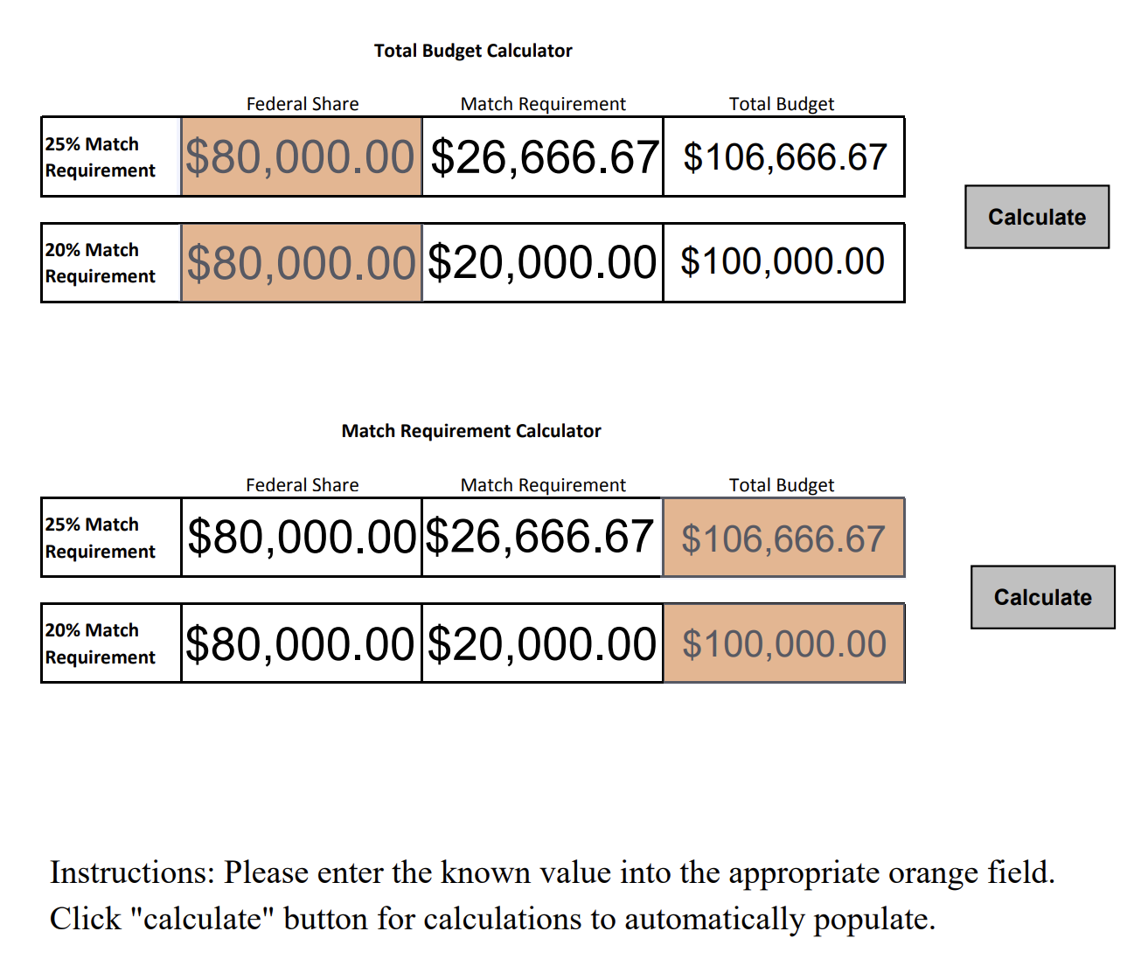
Match Calculator https://www.ncdps.gov/documents/files/match-funding-calculator/open
Notes:
SANDY
A match calculator can be found at the link listed here in red.
It is a helpful resource when determining or checking your total project budget’s federal share and match share for accuracy.
Based on your percent match requirement, 20 or 25%, choose the method of calculation
In example 1, you may know the federal share that you will need from GCC and need to know the corresponding match amount you will have to provide, or
In example 2, you do know the total project budget and want to know how much of the total budget that you will need to provide as the match share.
Simply enter the dollar amount in the orange field and press the calculate button depending on which situation you are trying to determine.

Slide 27
Acceptable forms of Match
Cash Match
Money supplied by grantee or third party
In-Kind Match:
Non-Cash Donations
Notes:
SANDY
Now, let’s look at acceptable forms of match.
The most common is a Cash Match. This form of match could come from a grantee's own funds, cash donations from third parties such as a fundraising event which generates unrestricted cash for your agency, foundation grants or grants from other nonfederal government agencies to name a few examples.
Another form of match is in-kind match or non-cash donations to the project. It is the inkind value of these contributions that is the match. Note that inkind match does not require your agency to make a cash payment for the contribution. Some examples of in-kind match include the fair market value of property rent, services that are donated by local professionals, volunteers providing services for the project, and more. As you work to identify and secure your match, remember that each match item must be properly valued and documented the same way as all other budget lines.
In-Kind Match requires fair market assessment and may be a bit more complicated. For example, for property- the fair market value must be established by an independent appraiser. The value of services provided by consultants and other personnel, must be consistent with what the grantee would pay their own staff for similar work or with the local market value for the work performed. Time contributed by a volunteers must be valued for the actual work performed as well.

Slide 28
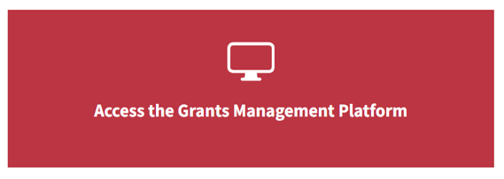
Match Summarize & Review
$
$
Match Funding
Match Share Contribution
Cash vs In-Kind
$200K
GCC
80%
$
$
Document Match in EBS
Match Waiver Request
RFA
Notes:
SANDY
So, to summarize, match funding is the portion of a project not supported or paid for by the federal funding source.
Match may or may not be required, depending on the funding source to which you have applied, so read the GCC RFAs carefully.
Additionally, Match demonstrates a strong base of non-federal, financial and partner support.
Match is always subject to the same regulations and restrictions as the federal funds that you receive from GCC.
Depending on the federal funding sources, cash and/or in-kind contributions may be allowed as a form of match.
Finally, if you cannot provide the match amount, you must request a match waiver at the time of application.

Slide 29
Indirect Costs
There are two types
De Minimis
Federally Negotiated Indirect Cost Rate Agreement (NICRA)
Notes:
NAVIN
De Minimis Indirect Cost Rate
OR
A Federally negotiated indirect cost rate also known as a NICRA

Slide 30
Indirect costs – De Minimis
Changed from 10% to 15% for new applications starting 10/1/2024
The de minimis rate is 15% of modified total direct costs (MTDC)
The MTDC base includes: salary and wages, fringe benefits, materials and supplies, services, travel, and the first $50,000 *UPDATED* of each contract.
Excluded from the MTDC calculation is: equipment, capital expenditures, charges for patient care, tuition remission, rental costs, scholarships, and the portion of any contracts in excess of $50,000.
If you elect to use de minimis in your projects, you must submit and upload a certification to the Organization Documents. If you are using direct costs only then upload a “does not apply” statement to the Organization Documents section in EBS. The De Minimis Certification Form can be found:
https://www.ncdps.gov/about-dps/boards-and-commissions/governors-crime-commission/grant-forms#application
Notes:
NAVIN
De Minimis Indirect Cost Rate
Some subrecipients have the option of using a de minimis indirect cost rate set by law. The de minimis rate is 15% of modified total direct costs (MTDC). Please note that his has changed from 10% to now 15%.
The MTDC base includes: salary and wages, fringe benefits, materials and supplies, services, travel, and the first $50,000 of each contract.
Excluded from the MTDC calculation is: equipment, capital expenditures, charges for patient care, tuition remission, rental costs, scholarships, and the portion of any contracts in excess of $50,000.
This de minimis rate is available without the need to negotiate with the cognizant federal agency for indirect costs. The de minimis rate is an option only for subrecipients that do not have an approved federally negotiated indirect cost rate.
When the de minimis rate is used, costs must be consistently charged as either indirect or direct costs. Double charging is not permitted.
If you elect to use de minimis, it must be applied consistently across all your agency’s Federally funded projects unless or until your agency receives a Federally Negotiated Indirect Cost Rate
If you elect to use de minimis in your projects, you must submit and upload a certification to the Organization Documents. The De Minimis Certification Form can be found at the Grant Forms section of our website.

Slide 31
Indirect Costs - NICRA
To use a federally negotiated indirect cost rate - NICRA:
Your organization must have a current, signed, federally approved indirect cost rate agreement with the cognizant federal agency
the federal agency from which the subrecipient receives the most funds
Upload the NICRA to the Organization Documents in EBS
If your NICRA has expired you may use the 15% de minimis rate.
Notes:
NAVIN
Applicants that intend to charge indirect costs through the use of a federally negotiated indirect cost rate must have a current, signed, federally approved indirect cost rate agreement (NICRA), which the agency will then use for all applications for federal funding.
The cognizant federal agency is the federal agency from which the subrecipient receives the most funds. Note this is the subrecipient, such as the county or state agency and not the implement agency, such as the sheriff’s office.
Documentation supporting the agency’s use of an indirect cost rate is required. You will upload the NICRA to the Organization Documents in EBS.
Since utilizing an indirect cost rate occurs at the organization level, the Financial Officer is responsible for the verification of an organization’s indirect cost rate (de minimis or federally negotiated rate). If an organization is utilizing an indirect cost rate, the required support documentation must be uploaded to the EBS Grants Management Platform by the Financial Officer.

Slide 32
We have reviewed…
GCC Committees and staff responsible for application questions
Budget categories and the details required for each budget line
Match - it may or may not be required by the funding source, so read the RFAs
Indirect Costs changes
Notes:
SANDY
READ

Slide 33
Thank you!
Notes:
NAVIN
We thank you for your time and attention this morning. Please enter your questions in the chat. All questions will be consolidated into an FAQ document and posted to our website.

