Slide 1
North Carolina Justice Data Portal Criminal Justice Analysis Center
GCC Grant Writing Workshop
October 12th, 2022

Slide 2
About CJAC
North Carolina’s Statistical Analysis Center
Part of the Justice Research and Statistics Association (JRSA)
Reestablished in 2018

Slide 3
The mission of the Criminal Justice Analysis Center is to analyze, facilitate, and promote data-informed criminal justice policy and programs in North Carolina.

Slide 4
Timeline
March 2022 (Initial Launch)
October 2022
Criminal Offenses
Traffic Summary
Victim-Offender Relationships
June 2022
Future Releases
Reported Offender Characteristics
Victim Demographics
Courts & Corrections

Slide 5
Justice Data Portal
JUSTICEDATAPORTAL.NC.GOV

Slide 6
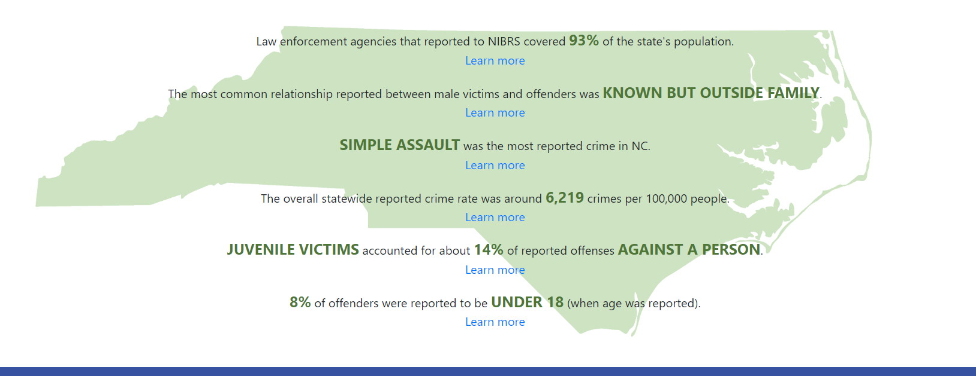

Slide 7
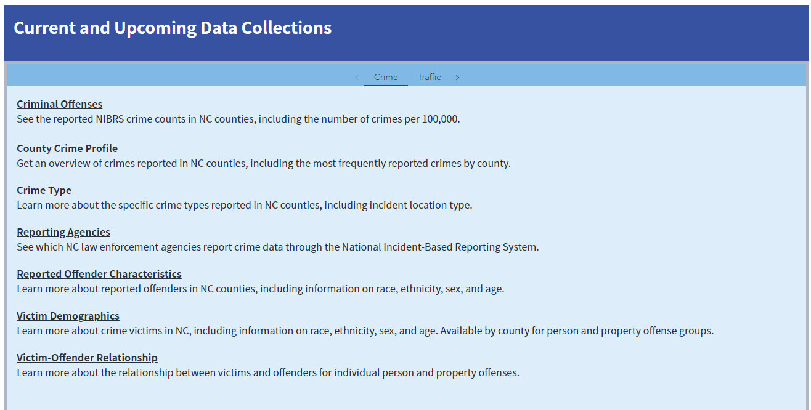

Slide 8
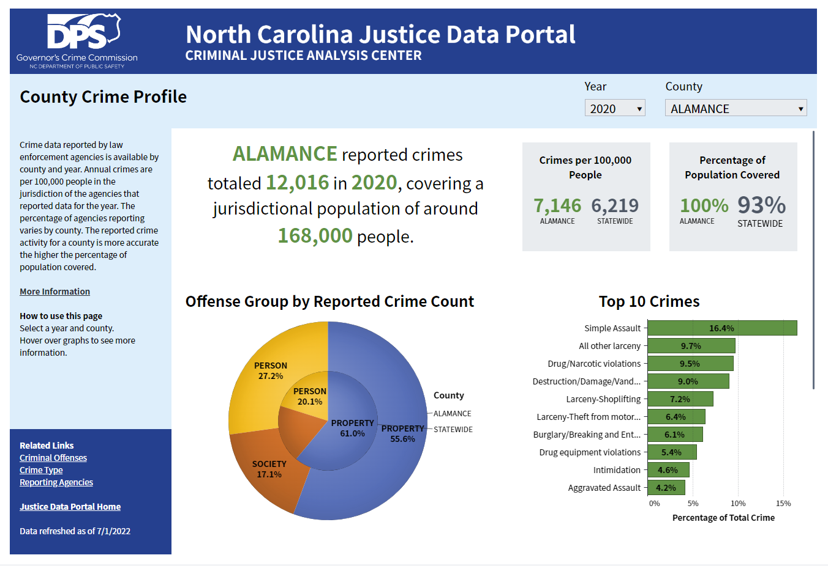
A brief overview of the data in the report.
Filter by Year and/or County.
Tips on how to interact with the report
Click on links to other reports or return to the home page.
Date of last data refresh

Slide 9
How can I use the Justice Data Portal to support my grant application?

Slide 10
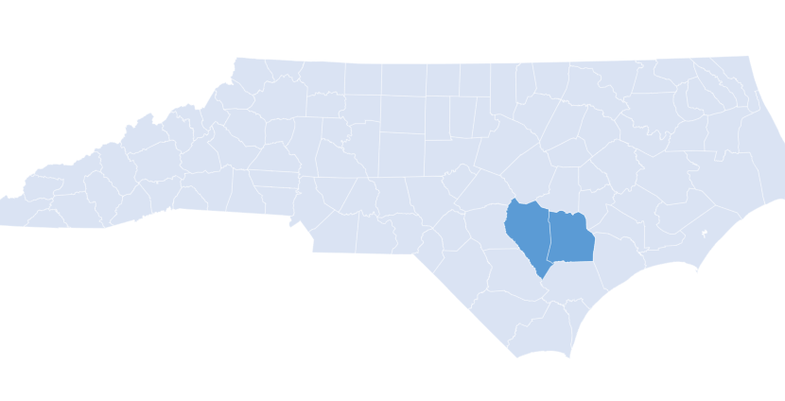
Example 1
Hispanic/Latino Victims in Duplin and Sampson Counties

Slide 11
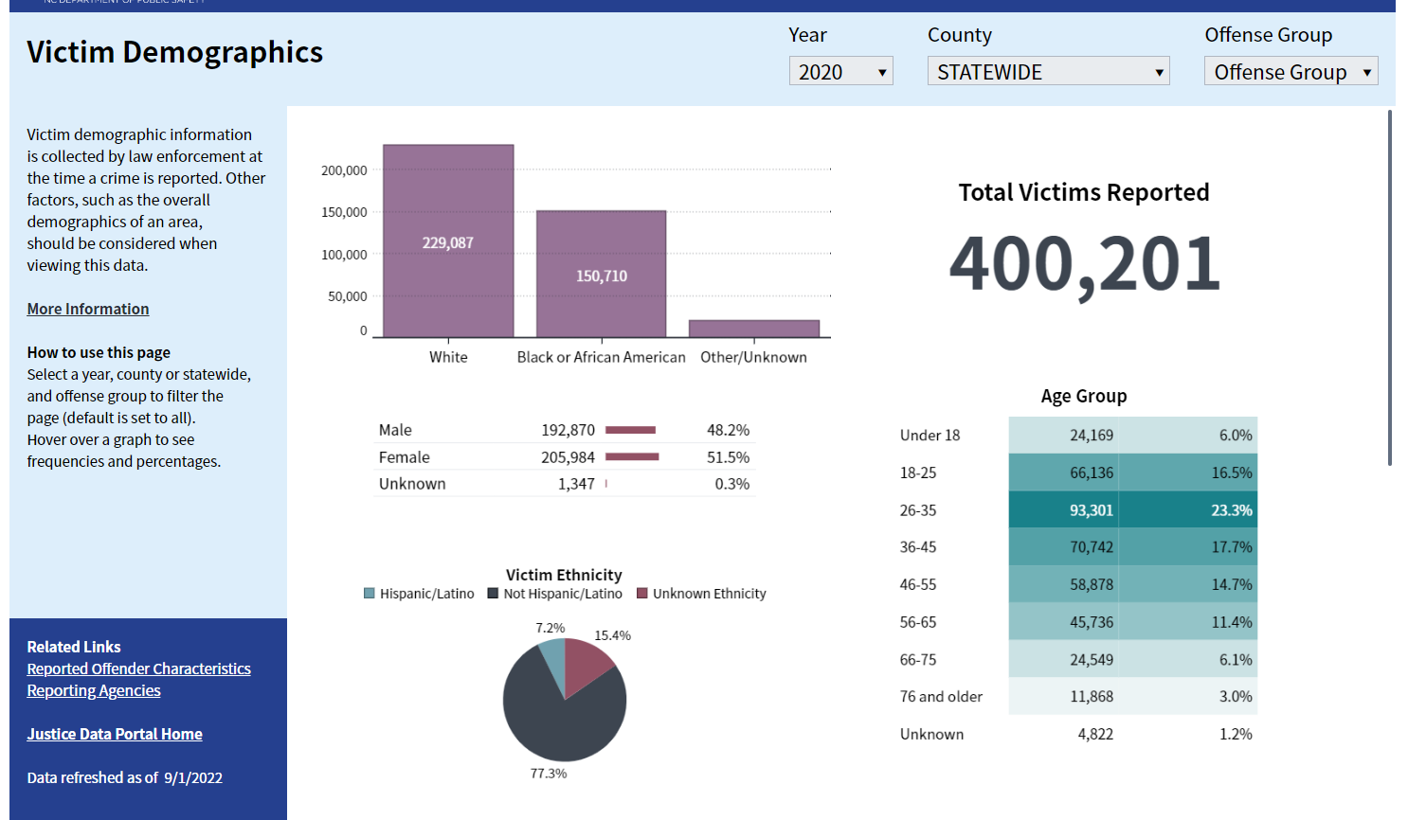
7.2% of reporting victims statewide were Hispanic/Latino

Slide 12
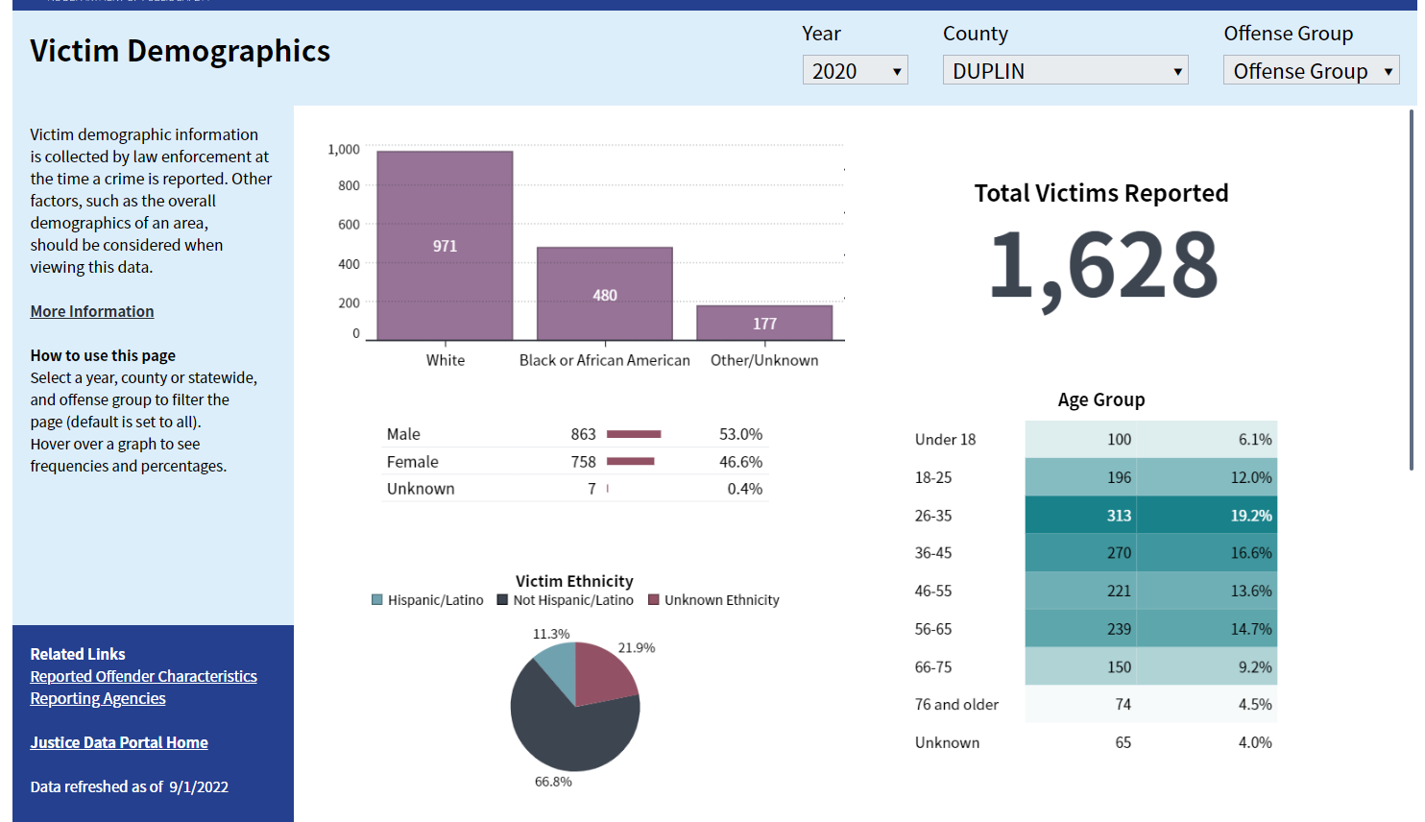
11.3% of reporting victims in Duplin County were Hispanic/Latino

Slide 13
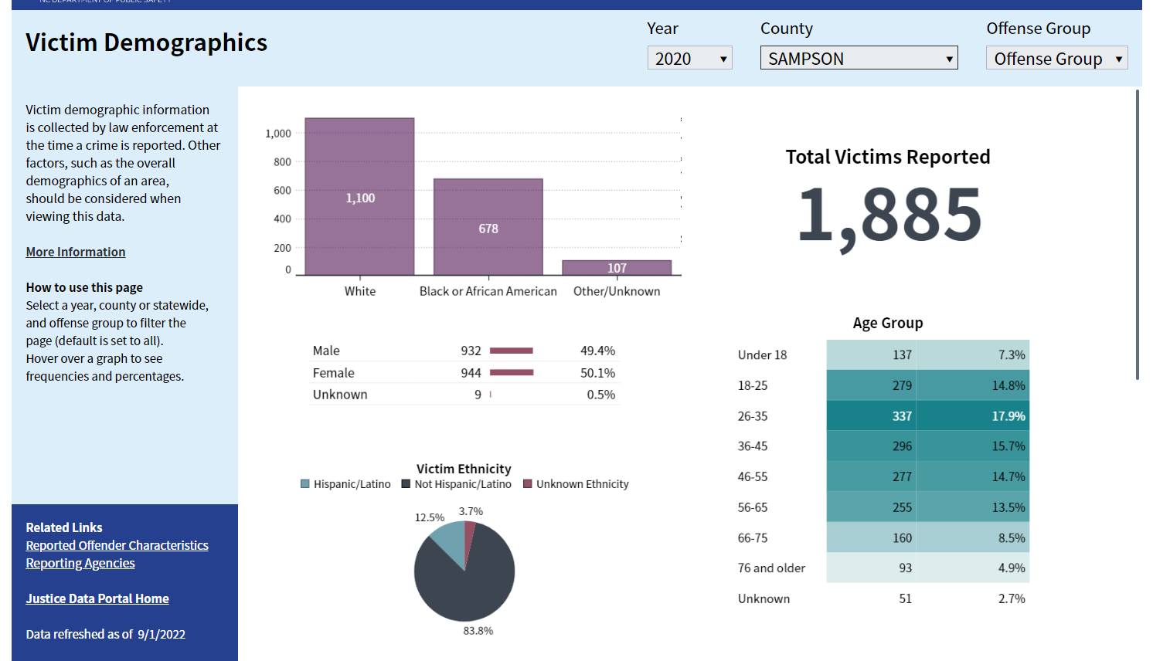
12.5% of reporting victims in Sampson County were Hispanic/Latino

Slide 14
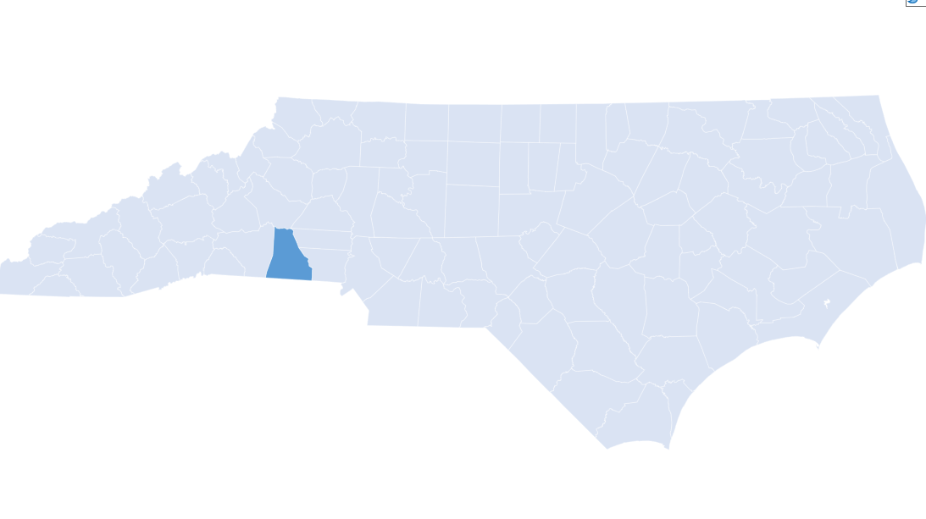
Example 2
Juvenile Victims in Cleveland County

Slide 15
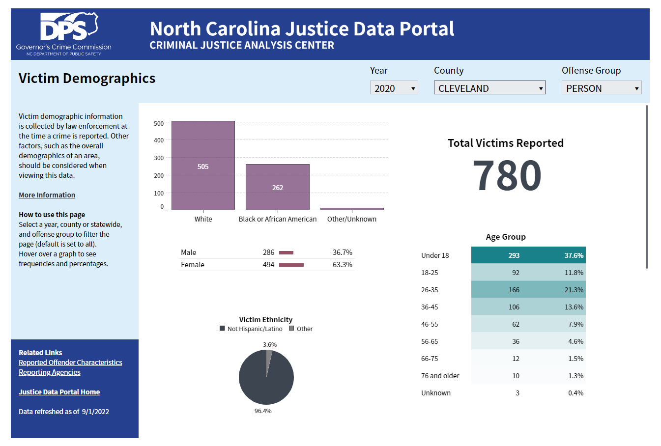
37.6% of reporting victims in Cleveland County were under 18

Slide 16
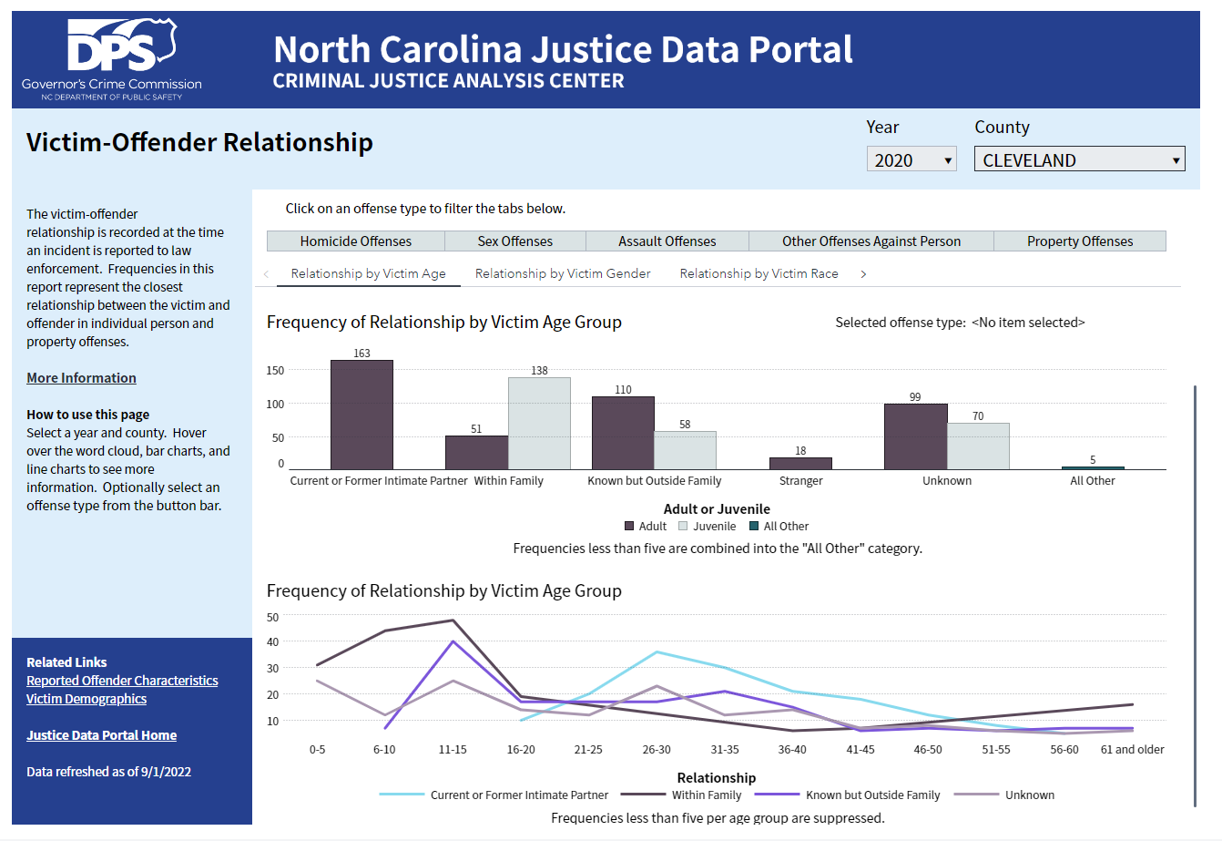
The most frequently reported relationship between juvenile victims and offenders was within family.

Slide 17
Thank you!
www.ncdps.gov/cjac
justicedataportal.nc.gov

