Slide 1
North Carolina Victims of Crime Needs Assessment
October 12th, 2022
Presented by: Tonya Van Deinse, PhD

Slide 2
Background
In late 2020, the Governor’s Crime Commission sought a research team to conduct a statewide needs assessment for victims of crime in NC to understand:
• What services are currently available and accessed by victims of crime?
• How do community members know/find out about resources or services?
• What victim services are needed but not available?
• What are the barriers to victims accessing services?
• What type of training or tools do organizations that provide services to victims need that they do not currently have?
• What capacity building efforts within victim service organizations are needed?
They also wanted to know whether and how the answers to these questions varied by specific underserved groups.

Slide 3
Our Proposal
Core elements
Interdisciplinary team
Community-engaged approach
Mixed-methods design
Expand priority population focus
Proposed timeline
18 mos.
Begin in January 2021

Slide 4
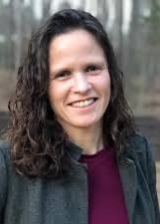
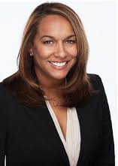
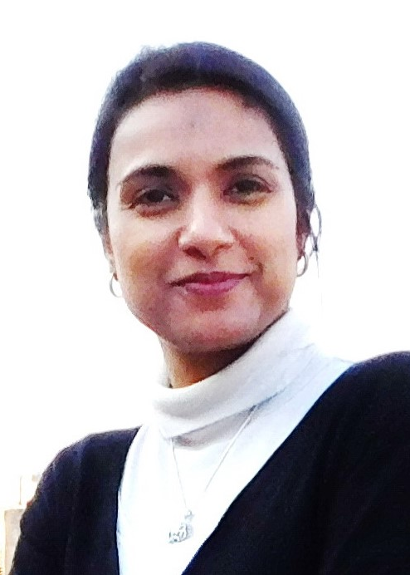
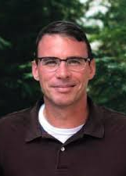
Our Interdisciplinary Team: Faculty
Tonya Van Deinse, PhD, MSW
Andrea Murray-Lichtman, MSW, LCSW
Dana Rice, DrPH, MS
Erum Agha, Ph.D., MSW, LCSW
Gary Cuddeback, PhD, MPH, MSW
School of Social Work
School of Social Work
Gillings School of Global Public Health
School of Medicine – Program on Integrative Medicine
School of Medicine – Department of Psychiatry

Slide 5
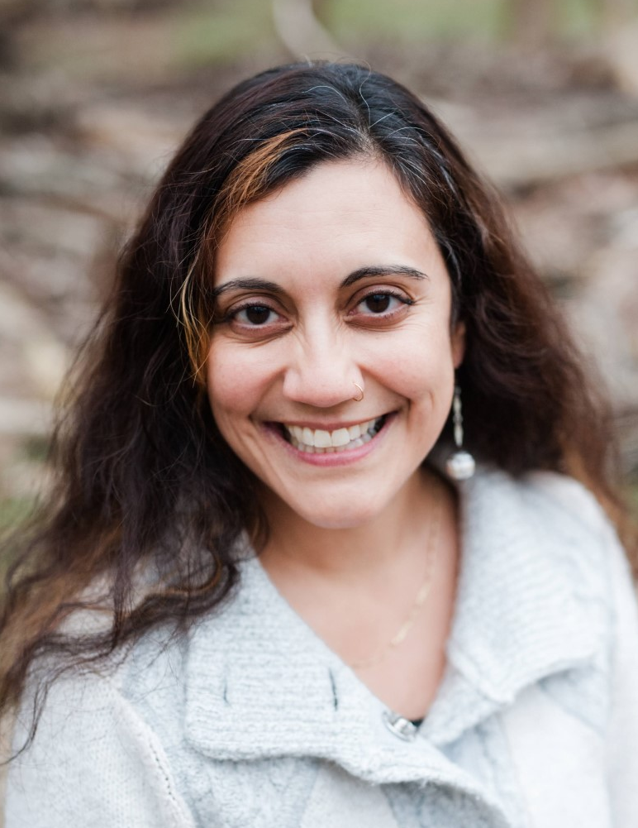
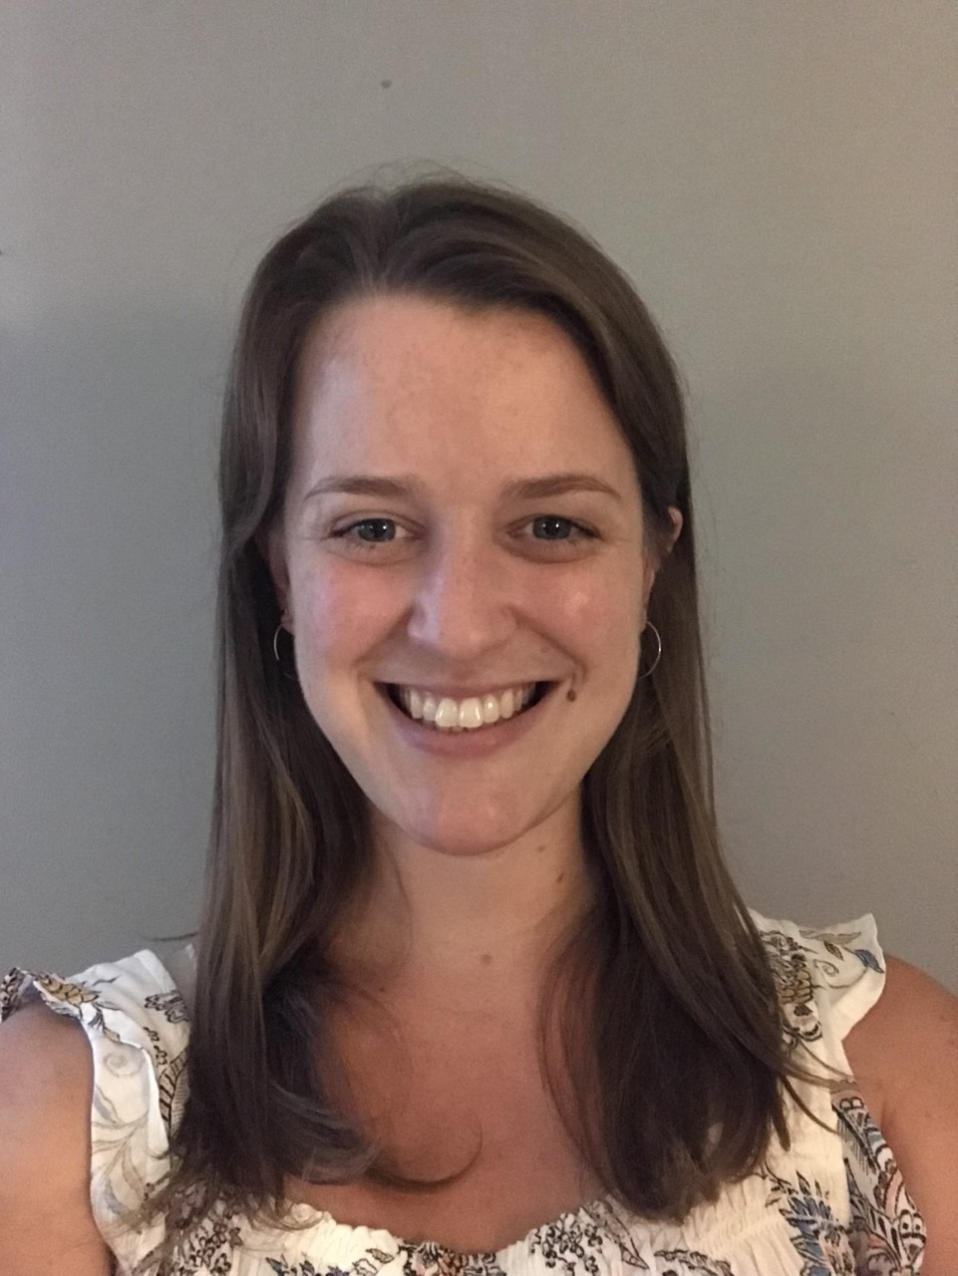
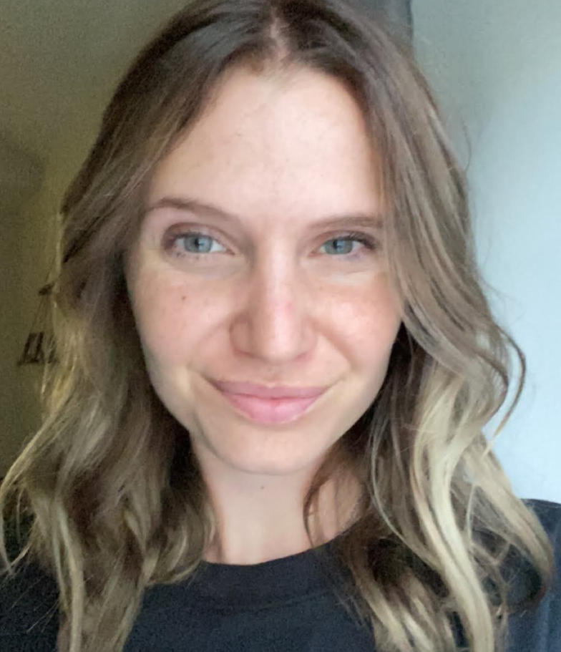
Our Interdisciplinary Team: Current Students
Emily Chávez,
MSW Candidate
Melissa Jenkins,
PhD Candidate
Ally Waters,
MSW Candidate
Mikayla Welch
MPH Candidate
School of Social Work
School of Social Work
School of Social Work
Gillings School of Global Public Health

Slide 6
Purpose of a Community Engaged Approach
Research is connected, grounded, and relevant to the community
Provides a diverse range of perspectives across geographical lines, priority populations, and crime type
Limits the unequal power dynamics found within traditional research methods
More adequately reflects the values of the communities that are affected
Builds relationships that foster trust and transparency

Slide 7
Our community engaged approach
Establish a community advisory board (CAB) comprised of community and organizational leaders, particularly those working with members from the study’s priority groups
Request CAB guidance and approval on all study methods
Integrate CAB members’ revisions on data collection tools
Ask CAB members to connect us with other community members to expand outreach efforts
Partner with CAB members and community groups to: interpret study results, form recommendations for the GCC, present findings, and create other deliverables

Slide 8
Mixed Methods Design
Objective​ | Methods​
Obj. 1: Identify victim and community needs for services and supports​ | Surveys of victims and co-victims of crime Review of the literature​ Survey of victim service organizations​​ Interviews with advocates and organizational leaders​
Obj. 2: Identify existing victim services in 100 NC counties​ | Web-based resource inventory​ Survey of victim service organizations​​
Obj. 3: Examine capacity of victim services organizations​ | Survey of victim service organizations ​​ Interviews with advocates and organizational leaders​
Obj. 4: Identify the barriers and challenges to accessing services​ | Surveys of victims and co-victims of crime Survey of victim service organizations​ Interviews with advocates and organizational leaders​

Slide 9
Priority populations include but are not limited to:
Individuals with limited English proficiency
Immigrants with undocumented status and documented status
Refugee populations
Individuals with disabilities
Older adults
LGBTQ+ individuals
Veterans
Teens
People from religious minority groups
Incarcerated individuals and those under community supervision
Individuals who are unhoused/experiencing homelessness
BIPOC communities (Black, Indigenous, and all people of color)
Co-victims of homicide

Slide 10
Crimes of interest include but are not limited to:
Murder
Sex offenses
Robbery
Assault
Arson
Burglary
Forgery
Fraud
Embezzlement
Vandalism
Human trafficking

Slide 11
Where are we now?
Survey of victim service organizations Responses gathered, in analysis
Survey of victims and co-victims of crime Designed, not yet launched
Interviews with service providers and advocates Complete
Literature review Complete
Web-based resource assessment Complete
Notes:
-

Slide 12
Questions?

Slide 13
Contact information
Tonya Van Deinse
Email: tbv@email.unc.edu
Phone: 919-962-6428

